Slide 1
Kaustubh Thirumalai

Slide 2
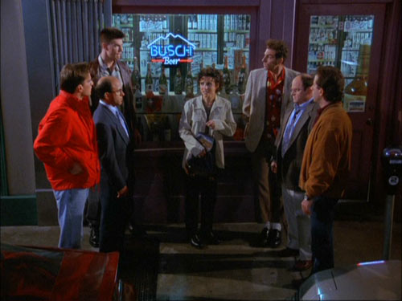
What is Academia Bizarro?
A lighter look at academia...
Importance?
Every week
Relevance to current Brown Bag
Geoscience-focus

Slide 3
What qualifies?
Plain bizarre science/academia
Articles containing outdated science
Historically relevant articles
Controversy
Witty/Sarcastic Literature

Slide 4
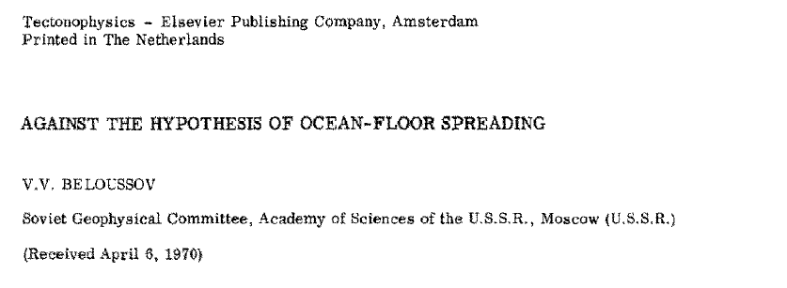
Outdated Science

Slide 5
Outdated Science

Slide 6
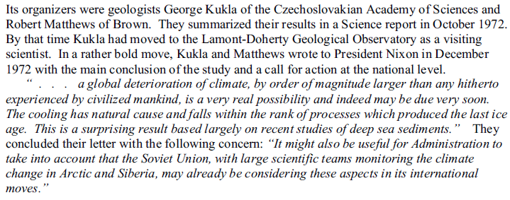
Historically Relevant Science

Slide 7
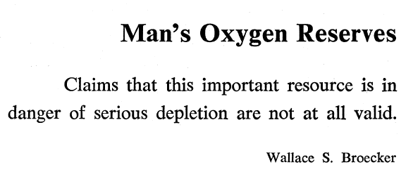
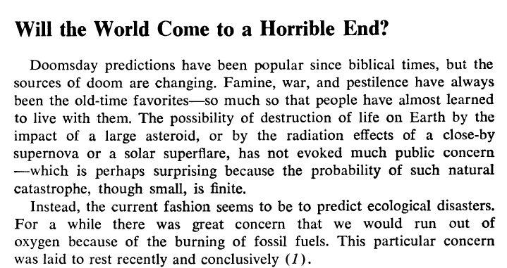
Historically Relevant Science

Slide 8
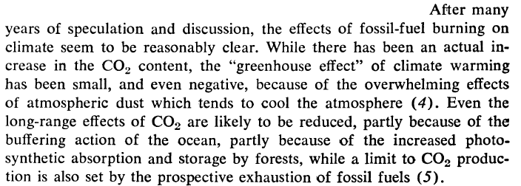
Historically Relevant Science
26 November 2008, Alex Jones’ Prison Planet

Slide 9
Witty Literature

Slide 10
Witty Literature

Slide 11
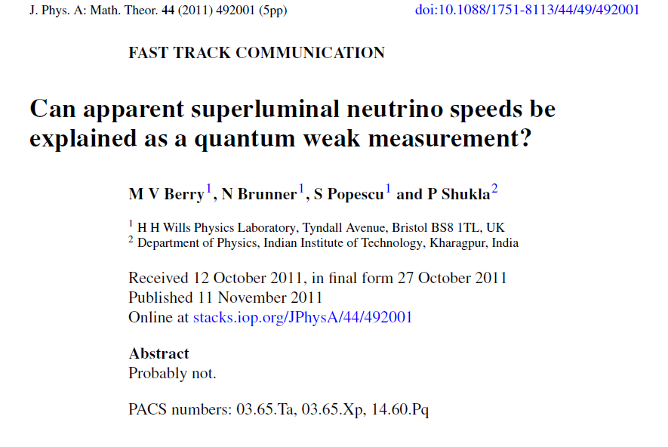
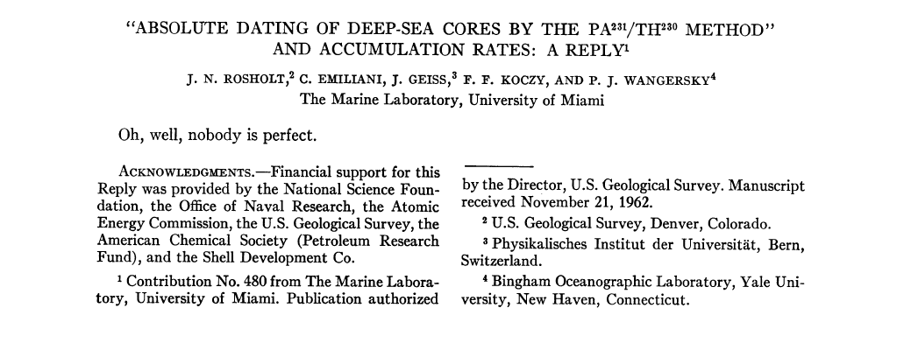
Witty Literature: Awesome Abstracts

Slide 12
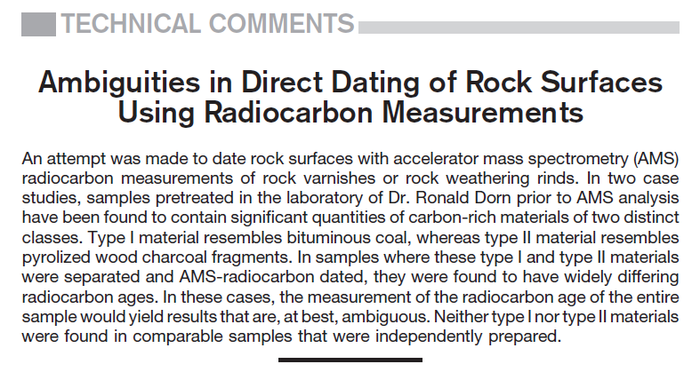
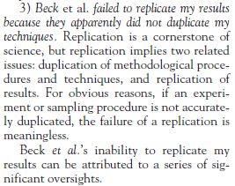
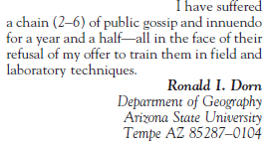
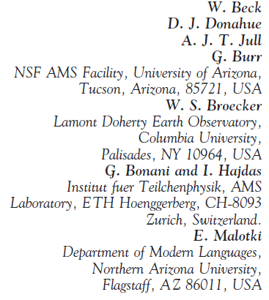
Controversy!

Slide 13
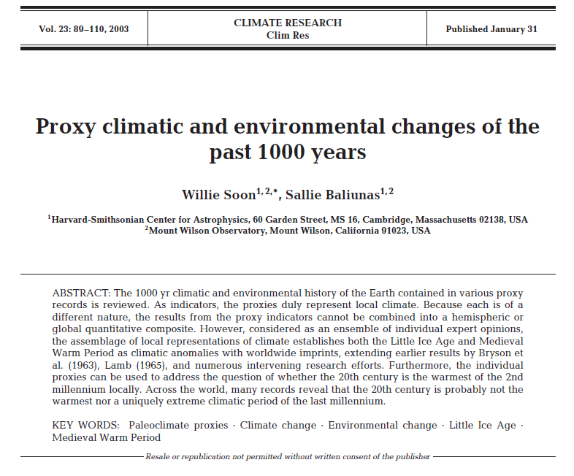
Controversy!
Cited 153 times!

Slide 14
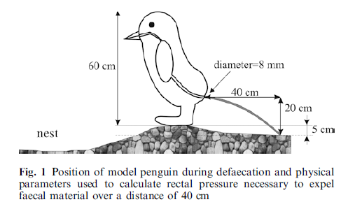
Bizarre Science!

Slide 15
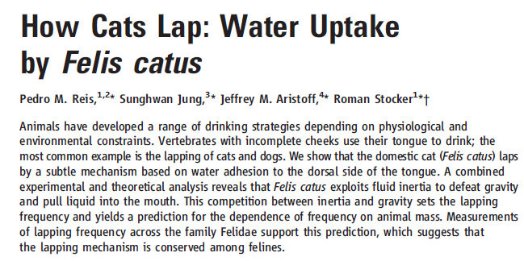
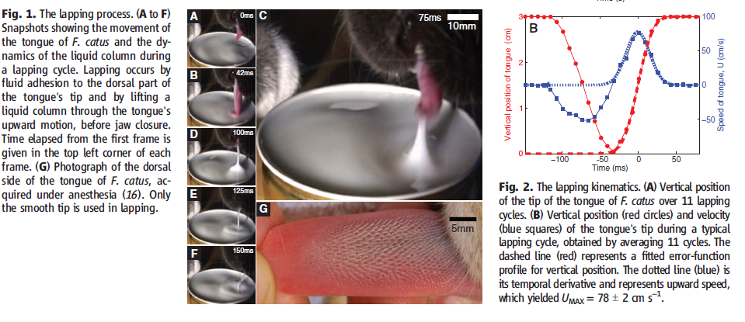
Bizarre Science!

Slide 16
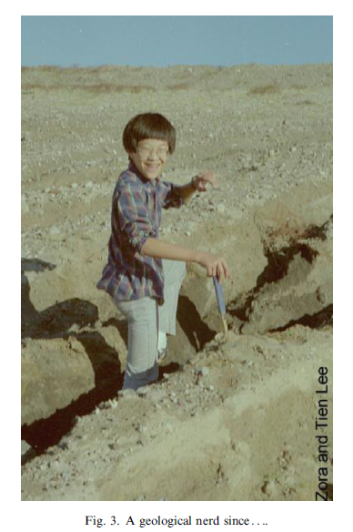
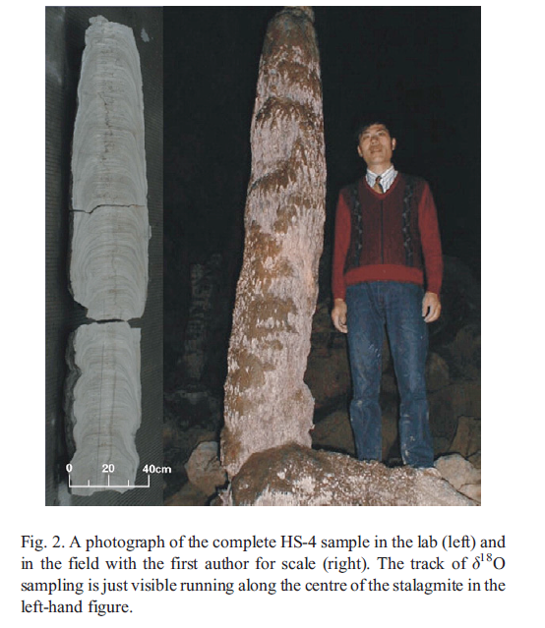
Quirky Field Pictures

Slide 17
Summary
1-2mins/Brown Bag
Preferably topic related
Archive
Welcome any/all suggestions!

